Slide 1








MediPres
- We Care for You

Slide 2
What is MediPres?
MediPres is an upcoming application that will help you take a call on what medicine best suits your needs.
It is a smart initiative which gives you suggestions regarding basic medication by simply stating conspicuous symptoms.

Slide 3
How Can MediPres Suggest Medication?
Let’s consider the case of a fever and you don’t quite recall the name of the medicine required but you’re quite sure the drug is OTC(Over the counter).
You can simply search on our application, we will provide a list of OTC drugs which are relatively harmless since they do not require a prescription.

Slide 4
How Does MediPres distinguish between Medicine ?
In many cases, the name of the drug might vary from manufacturer to manufacturer, however, the chemical composition is more or less, the same
A drug sold in Delhi for the common cold may not be abundantly available in other cities like Mumbai, Chennai, or Bangalore under the same name.
In such cases, pharmaceutics would recommend an alternative drug which they claim to be the same.
You can eliminate any ambiguity by simply verifying the chemical composition of the drug via MediPres and the application will run a simple search which will verify the same.

Slide 5


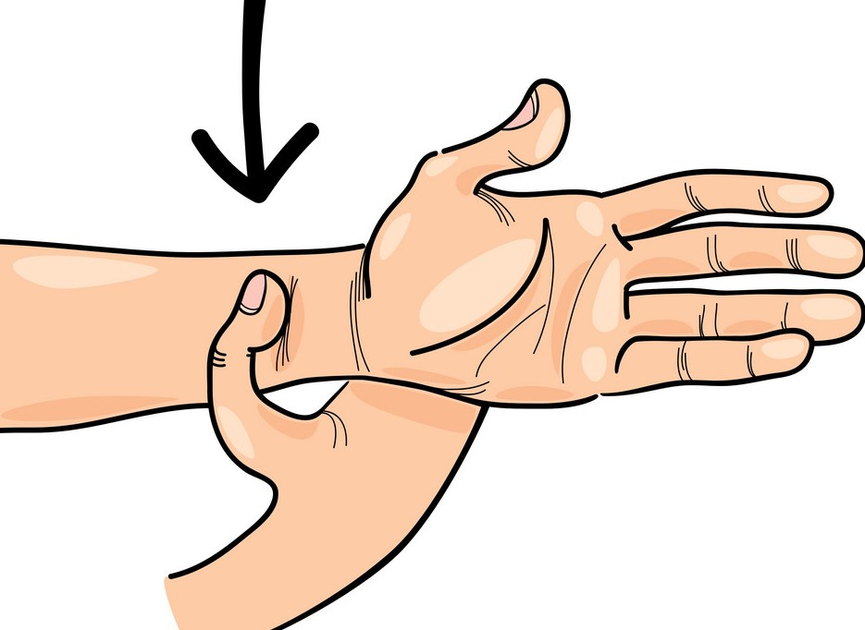



Other Salient Features of MediPres
Medical Prescription
Medicine Details
Acupressure Points
First Aid
Home Remedies
General Health Tips

Slide 6

The MediPres Team
We are creative and smart working people who believe in innovation to create a better lifestyle.
Team Members:
Aakarshak Arora (B.Tech IT , Manipal University Jaipur)
Kumar Nilind (B.Tech CS, Manipal University Jaipur)
Aditya Singhai (B.Tech IT, Manipal University Jaipur)
Mukund Sureshkumar (B.Tech ECE, Manipal University Jaipur)

Slide 7
This was all about MediPres
Hope Our Idea Bring Change people life because at
MediPres
-We Care for You

